Slide 1

Cloud Storage Technologies: Object, Block, and File Storage Compared
Presented by :
B Kusiya Anjum(192521383)
Guided by :DR.HEMAVATHI
Course code: CSA1511
Course Name: Cloud computing
TECHNICAL PRESENTAION

Slide 2
Introduction
What is Cloud Storage?
Cloud storage is a service that allows users to store, manage, and access data over the internet instead of using local storage devices. It provides secure, scalable, and reliable data storage.
Types of Cloud Storage
Object Storage
Block Storage
File Storage

Slide 3
TECHNICAL EXPLANATION
Object Storage
Stores data as objects with metadata.
Best for images, videos, backups, and cloud applications.
Example: Amazon S3, Google Cloud Storage.
Block Storage
Stores data in fixed-size blocks.
Offers high performance and low latency.
Best for databases and virtual machines.
Example: Amazon EBS.
File Storage
Stores data in files and folders.
Supports shared access through a file system.
Best for shared documents and file sharing.
Example: Amazon EFS, Google Drive.

Slide 4
IoT-Cloud Architecture
Components
User/Application
Internet
Cloud Storage Service
Storage Type
Object Storage
Block Storage
File Storage
Database
Backup & Recovery
Working Process
User → Internet → Cloud Storage Platform → Data Stored → Retrieve Data

Slide 5
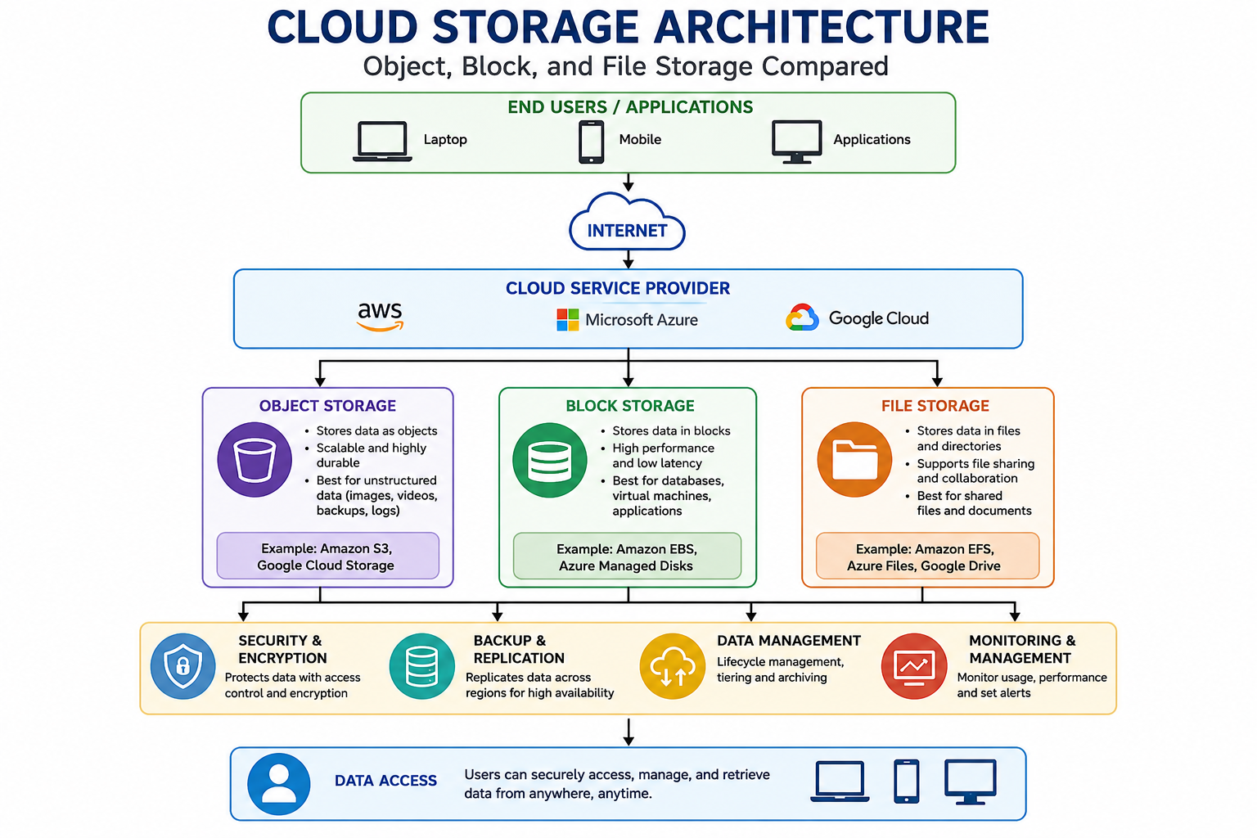
Architecture Diagram

Slide 6
Real-World Applications
Applications
Google Drive
Dropbox
Microsoft OneDrive
Amazon S3
Netflix Media Storage
Healthcare Data Storage
Banking Data Backup
Educational Cloud Platforms

Slide 7
Example Use Case
Working Process
User Uploads File
↓
Internet
↓
Google Cloud Storage
↓
Stores File Securely
↓
User Accesses File Anytime
Advantages
Easy file sharing
Automatic synchronization
Secure backup
Access from multiple devices

Slide 8
Conclusion and Key Takeaways
Conclusion
Cloud storage provides secure, scalable, and reliable storage solutions over the internet. Different storage types are designed for different purposes, helping organizations efficiently manage and access their data.
Key Takeaways
✔ Object Storage stores large unstructured data.
✔ Block Storage offers high performance for databases.
✔ File Storage organizes data into files and folders.
✔ Cloud storage improves accessibility, security, and scalability.
✔ Used by businesses, healthcare, education, and cloud applications.

Slide 9


Thank You!!!

